Slide 1

Basic Details of the Team and Problem Statement
Ministry/Organization Name/Student Innovation:
AICTE, MIC-Student Innovation
PS Code: SIH1475
Problem Statement Title: Student Innovation
Team Name: Little Six Better Fix
Team Leader Name: Nishchit Y V
Institute Code (AISHE): C-1307
Institute Name: City Engineering College, BANGALORE
Theme Name: Robotics and Drones

Slide 2
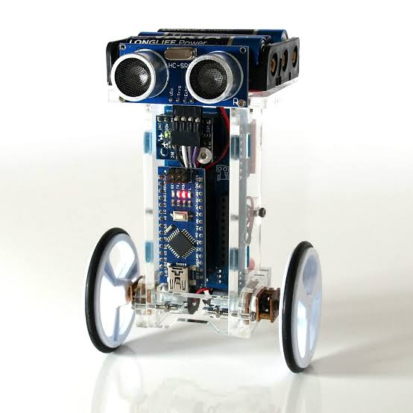
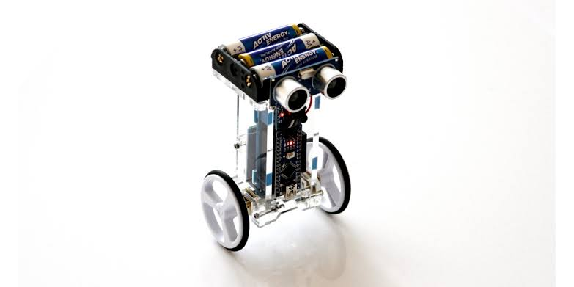
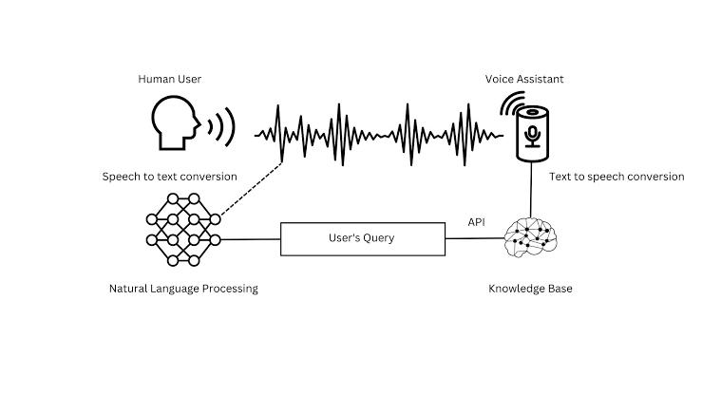
Idea/Approach Details
SMERA
Describe your idea/Solution/Prototype here:
SMERA- Smart Mechatronics Robot Assistant
Interactive domain specified robo.
Interaction in 4-5 different languages.
Sweetest voice assistant (one of your favourite companion).
It could be further Application in warehouse management.
It can also be used as receptionist in various sectors.
Children funny learning toy.
Describe your Technology stack here:

Slide 3
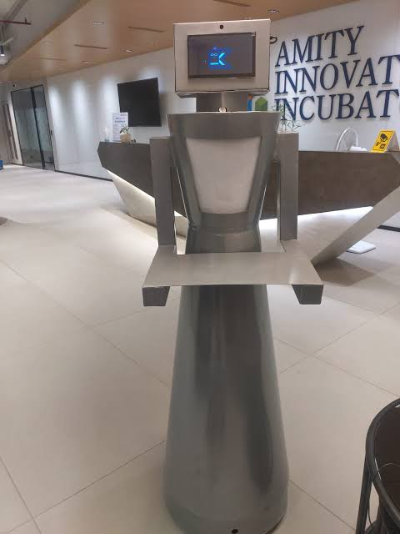
Idea/Approach Details
Describe your Use Cases here
Describe your Dependencies / Show stopper here
Voice-based Search .
Answering questions about products and helping customers/clients troubleshoot issues.
Hospitality management of clients/customers without language barrier.
Help desk tasks in various sectors.
More languages compatiblity.
Advanced neural networking.
Implementation of deep learning
Smarter and device compatibility
Etc…..

Slide 4
Team Member Details
Team Leader Name: Nishchit Y V
Branch : Btech Stream :AI&ML Year : II
Team Member 1 Name: Vivek kumar
Branch : Btech Stream :AI&ML Year : I
Team Member 2 Name: Harshavardhan G
Branch : Btech Stream : AI&ML Year : I
Team Member 3 Name: Gagan D N
Branch : Btech Stream :AI&ML Year : II
Team Member 4 Name: Raihan shariff
Branch : Btech Stream :AI&ML Year : II
Team Member 5 Name: Sharon Sara
Branch : Btech Stream :CS Year : II
Team Mentor 1 Name: Asst.prof. Vindhya R
Category : Academic Expertise : AI&ML, Data science Domain Experience (in years): 6+
Team Mentor 2 Name: Dr. S.Vagdevi
Category : Academic Expertise : AI&ML, Data science Domain Experience (in years): 8+

